Slide 1
The Limits to Growth: Sustainability and the Circular Economy
Lecture 4: Sustainability and Political (In-)Action
Prof. Dr. Benjamin Leiding
M.A. Theresa Sommer M.Sc. Anant Sujatanagarjuna

Slide 2
License
This work is licensed under a Creative Commons Attribution-ShareAlike 4.0 International License. To view a copy of this license, please refer to https://creativecommons.org/licenses/by-sa/4.0/ .
Updated versions of these slides will be available in our Github repository.

Slide 3
News/Updates/Org

Slide 4
Course Organization - Asynchronous Learning & MOOC content
Massive Open Online Course
Remote and (often) asynchronous online courses not just for students enrolled in a specific university but ideally open for everybody
Usually consists of pre-recorded lectures, interactive content and online quizzes
Some of you might have visited MOOC on platforms such as edX, LinkedIn Learning, Coursera, Udacity, etc. before
Course Website – Link
Lectures L06, L07, L08 and L09 are going to be MOOC lectures.
There will be no live lectures on Wednesdays, but we will have live exercises.

Slide 5
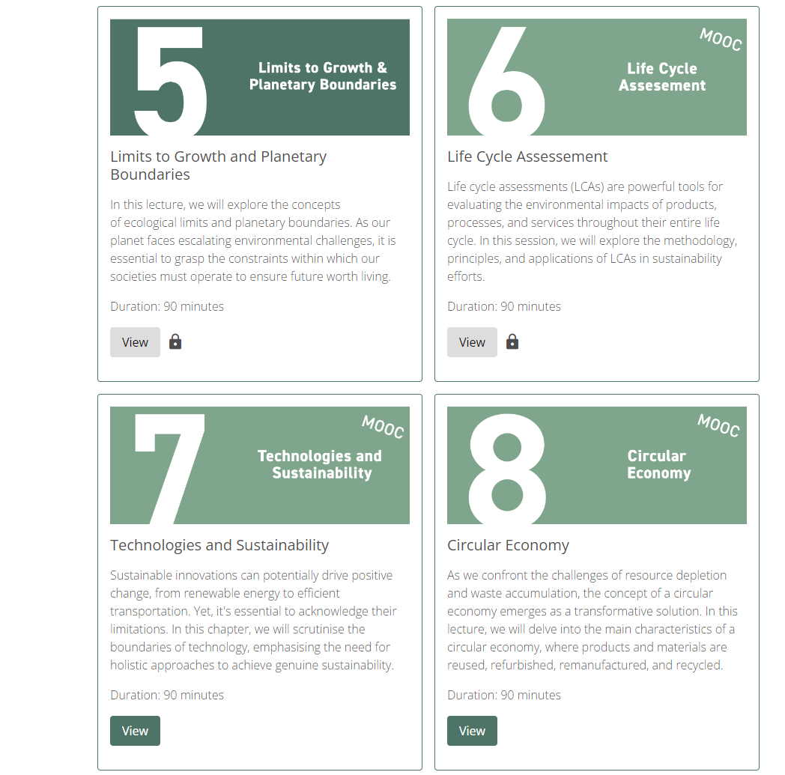
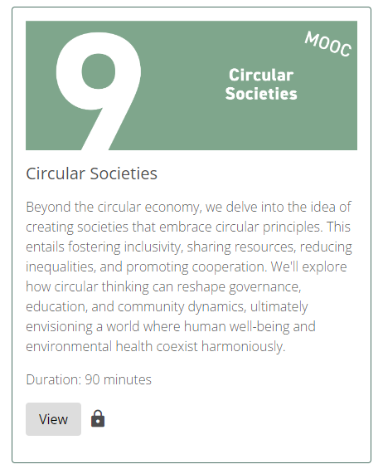
Lecture Plan
Week 6 (11.12 – 15.12.2023)
Week 7 (18.12 – 22.12.2023)
Week 8 (08.01 – 12.01.2024)
Week 9 (15.01 – 19.01.2024)
Exercise 6 + 7 20.12.2023 3.00 p.m.
Exercise 8 10.01.2024 3.00 p.m.
Exercise 9 17.01.2024 3.00 p.m.

Slide 6
Q&A Session
Exercise / Q&A:
Wednesdays 3:00 pm (Berlin time)
BigBlueButton (Link)
Exercises still have to be given in until the exercise deadline noted in the exercise sheets. Exercise sheets are on the website or our GitHub Repository (Link).

Slide 7
E02 – Carbon Footprint

Slide 8
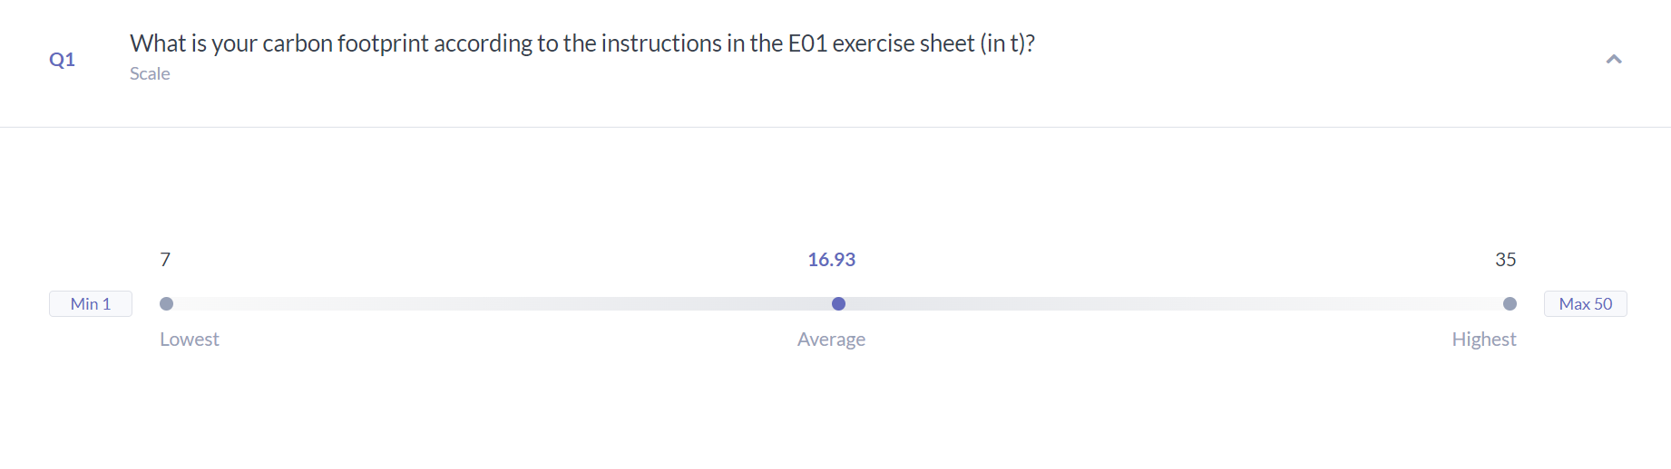
E02 – Carbon Footprint
Results

Slide 9
Sustainable Development Goals

Slide 10

Sustainable Development Goals
Important Actors
United Nations
Largest intergovernmental organization in the world
193 members
Established in 1945
Main aims: maintaining international peace, international cooperation
Organized in six principal bodies and autonomous specialized agencies
e.g. General Assembly, Security Council, UN Secretariat
e.g. World Health Organization (WHO), World Bank Group (WBG), Food and Agriculture Organization (FAO)
Flag of the United Nations – designed by Donal McLaughlin, Public domain, via Wikimedia Commons – https://en.wikipedia.org/wiki/Flag_of_the_United_Nations#/media/File:Flag_of_the_United_Nations.svg
Notes:
Logo einfügen?

Slide 11
Sustainable Development Goals
Overview
Sustainable Development Goals → SDGs
17 interlinked goals
Proposed in 2015 by the United Nations General Assembly
To be achieved by 2030 by all UN member states
Each goal typically has 8–12 targets, and each target has between 1-4 indicators used to measure progress toward reaching the targets.
“A blueprint to achieve a better and more sustainable future for all people and the world by 2030” – United Nations General Assembly

Slide 12
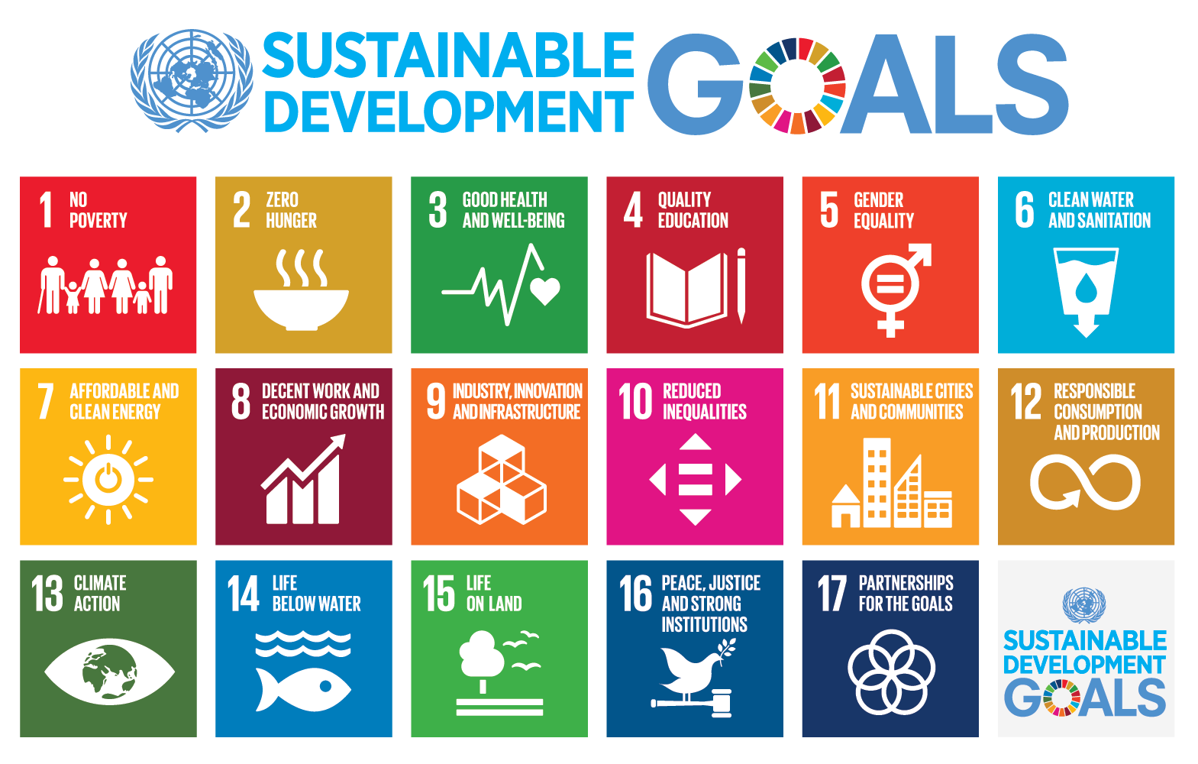
Sustainable Development Goals
Sustainable Development Goals – Unknown author, Public domain, via Wikimedia Commons – https://commons.wikimedia.org/wiki/File:Sustainable_Development_Goals.png

Slide 13
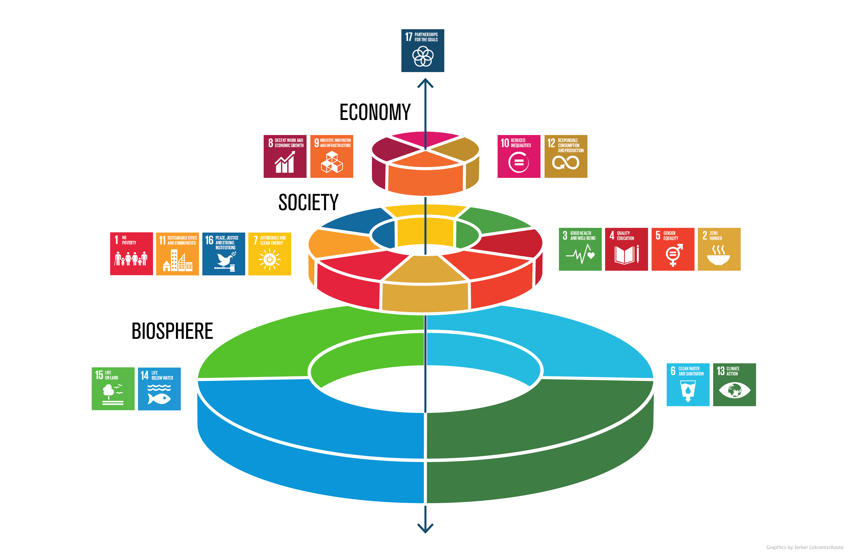
Sustainable Development Goals
Challenges
The SDGs cover all three dimensions of sustainability: economic, ecological and social
Many of the goals focus on society
No prioritization between different goals
“The means of implementation targets under each Sustainable Development Goal and Goal 17, which are referred to above, are key to realizing our Agenda and are of equal importance with the other Goals and targets. We shall accord them equal priority in our implementation efforts and in the global indicator framework for monitoring our progress.”
SDG wedding cake – Azote for Stockholm Resilience Centre, Stockholm University, Public domain, via Wikimedia Commons – https://commons.wikimedia.org/wiki/File:SDG_wedding_cake.jpg
United Nations General Assembly (2015) – Resolution adopted by the General Assembly on 25 September 2015 – https://upload.wikimedia.org/wikipedia/commons/d/d5/N1529189.pdf

Slide 14
Sustainable Development Goals
Challenges
Water, food and energy are vital prerequisites for any human life → other goals cannot be achieved without them
Each goal by itself does not guarantee sustainability
Achieving all goals is quite challenging → Stakeholders focus on particular goals which risks to achieve all goals (no sustainability if we just achieve 8 out of 17 goals)
Potential/risk for/of greenwashing

Slide 15
Sustainable Development Goals
Challenges
Water, food and energy are vital prerequisites for any human life → other goals cannot be achieved without them
Each goal by itself does not guarantee sustainability
Achieving all goals is quite challenging → Stakeholders focus on particular goals which risks to achieve all goals (no sustainability if we just achieve 8 out of 17 goals)
Potential/risk for/of greenwashing

Slide 16
Sustainable Development Goals
Challenges
Water, food and energy are vital prerequisites for any human life → other goals cannot be achieved without them
Each goal by itself does not guarantee sustainability
Achieving all goals is quite challenging → Stakeholders focus on particular goals which risks to achieve all goals (no sustainability if we just achieve 8 out of 17 goals)
Potential/risk for/of greenwashing

Slide 17
Sustainable Development Goals
Challenges
Water, food and energy are vital prerequisites for any human life → other goals cannot be achieved without them
Each goal by itself does not guarantee sustainability
Achieving all goals is quite challenging → Stakeholders focus on particular goals which risks to achieve all goals (no sustainability if we just achieve 8 out of 17 goals)
Potential trade-offs and incompatibility between different goals
Zero Hunger vs. Environmental Stability (Life Below Water, Life On Land)
Economic Growth vs. Decent Work

Slide 18
Sustainable Development Goals
Challenges
Water, food and energy are vital prerequisites for any human life → other goals cannot be achieved without them
Each goal by itself does not guarantee sustainability
Achieving all goals is quite challenging → Stakeholders focus on particular goals which risks to achieve all goals (no sustainability if we just achieve 8 out of 17 goals)
Potential trade-offs and incompatibility between different goals
Zero Hunger vs. Environmental Stability (Life Below Water, Life On Land)
Economic Growth vs. Decent Work
Potential/risk for/of greenwashing

Slide 19
A Short History of Actions on Climate Change

Slide 20
A Short History of Actions on Climate Change
(Incomplete) Timeline
1957 – First climate change warnings issued by Roger Revelle and Hans Suess
1958 – Start of systematic measurements of atmospheric CO2 by Dave Keeling
1972 – United Nations Conference on the Human Environment (Stockholm)
1979 – First World Climate Conference (Geneva)
1988 – IPCC (Intergovernmental Panel on Climate Change) founded
1992 – Earth Summit (Rio)
1997 – Kyoto Protocol
2009 – Copenhagen Accord
2015 – Paris Agreement
2021 – Glasgow Climate Pact

Slide 21
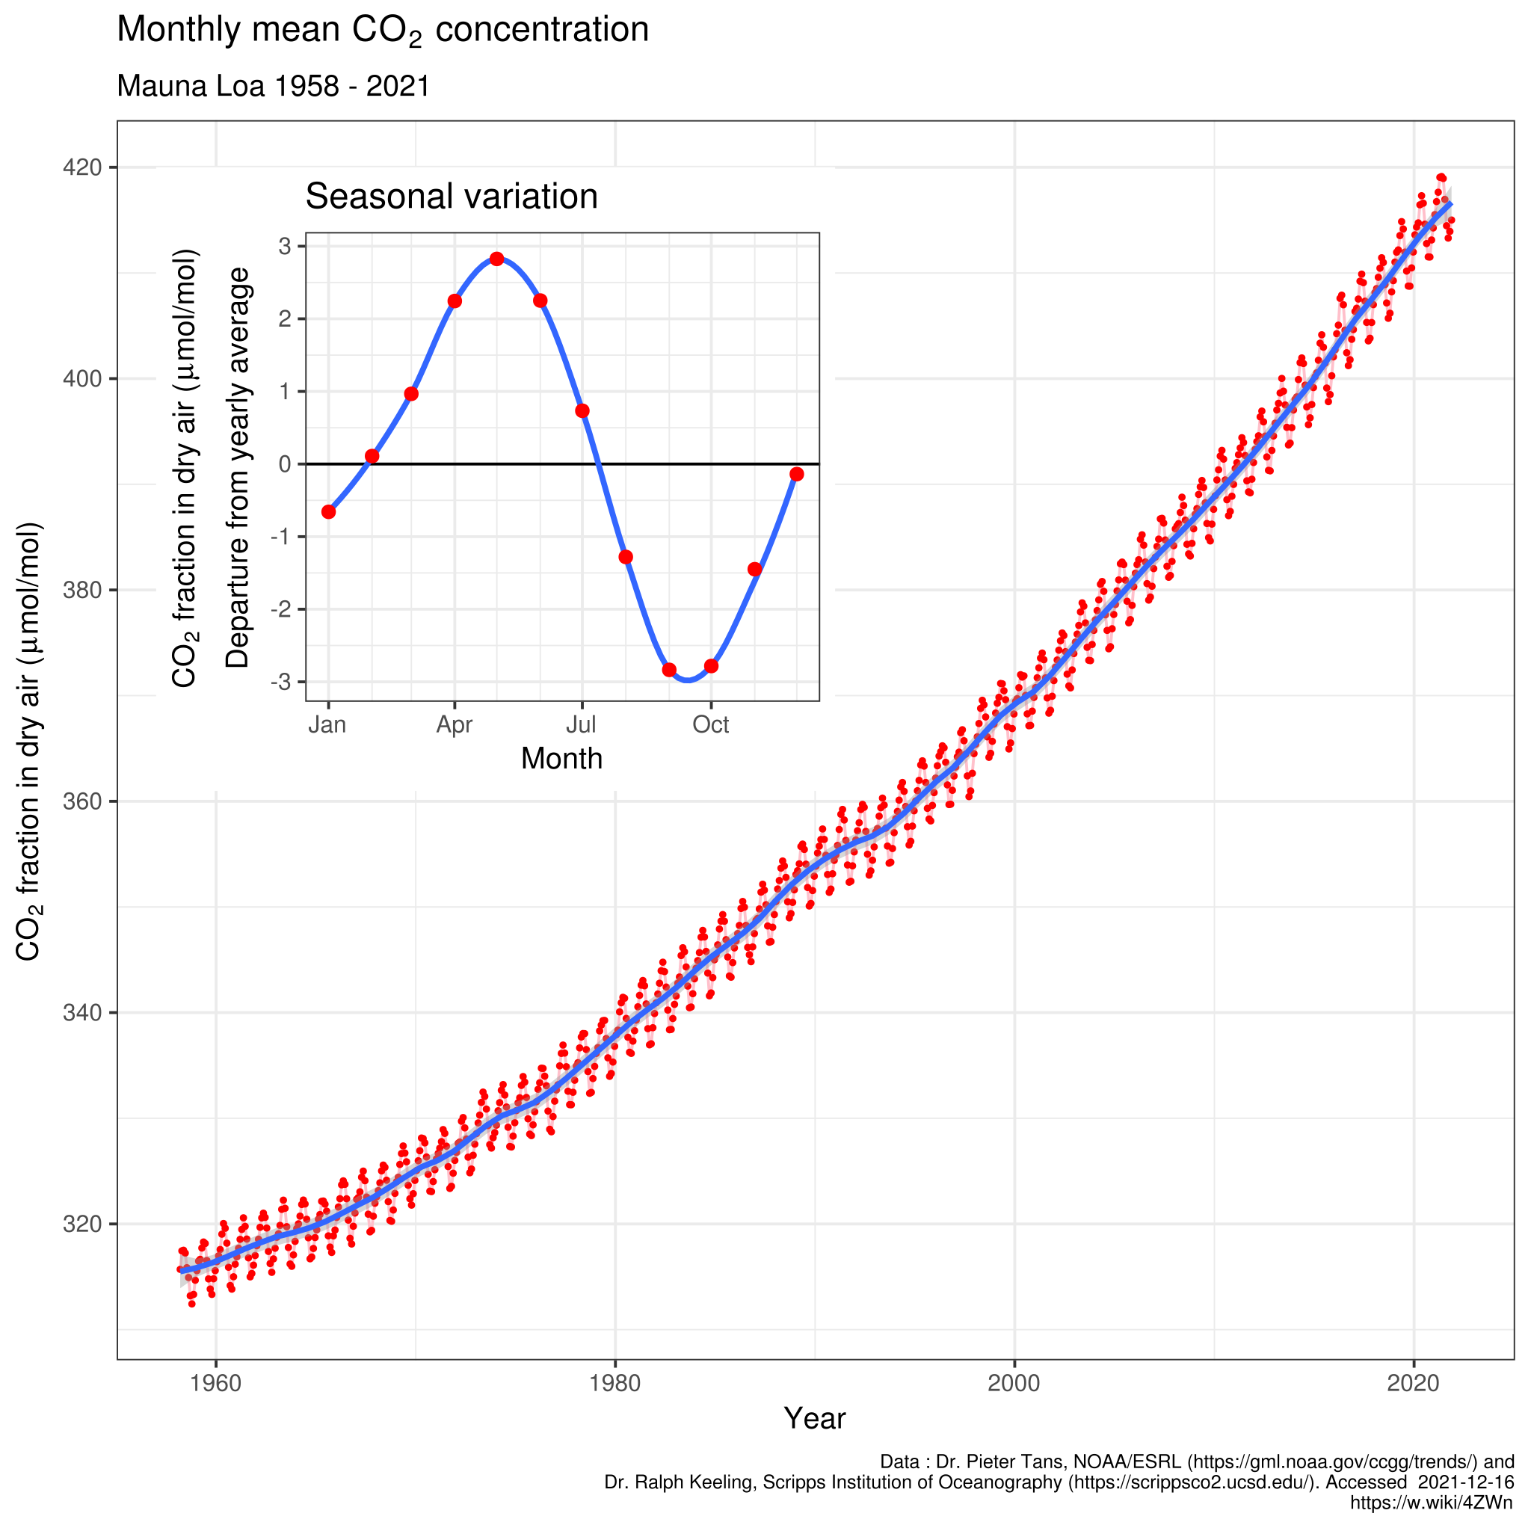
A Short History of Actions on Climate Change
Detour – Keeling Curve
Named after Charles David Keeling
Graph representation of the accumulation of CO2 in the atmosphere based on continuous measurements (Mauna Loa Observatory – Hawaii) from 1958 to the present day
Delorme – https://commons.wikimedia.org/wiki/File:Mauna_Loa_CO2_monthly_mean_concentration.svg – CC BY-SA 4.0.

Slide 22
A Short History of Actions on Climate Change
1979 – First World Climate Conference (Geneva)
First major meeting on climate change
Initiated by the World Meteorological Organization (WMO)
Scientific gathering explored how climate change might affect human activities
Led to the creation of the Intergovernmental Panel on Climate Change (IPCC)
Urged governments “to foresee and prevent potential man-made changes in climate that might be adverse to the well-being of humanity”
https://unfccc.int/cop3/fccc/climate/fact17.htm

Slide 23
A Short History of Actions on Climate Change
1988 – IPCC (Intergovernmental Panel on Climate Change)
Intergovernmental body of the United Nations
Task: “Provide policymakers with regular assessments of the scientific basis of climate change, its impacts and future risks, and options for adaptation and mitigation”
IPCC assessments:
provide a scientific basis for governments to develop climate related policies
are policy-relevant but not policy prescriptive: they may present projections of future climate change based on different scenarios and the risks that climate change poses and discuss the implications of response options, but they do not tell policymakers what actions to take.
A
re written by hundreds of leading scientists who volunteer their time and expertise as Coordinating Lead Authors and Lead Authors of the reports. They enlist hundreds of other experts as Contributing Authors to provide complementary expertise in specific areas
IPCC (2022) – https://www.ipcc.ch/about/

Slide 24
A Short History of Actions on Climate Change
1988 – IPCC (Intergovernmental Panel on Climate Change)
Intergovernmental body of the United Nations
Task: “Provide policymakers with regular assessments of the scientific basis of climate change, its impacts and future risks, and options for adaptation and mitigation”
IPCC assessments:
provide a scientific basis for governments to develop climate related policies
are policy-relevant but not policy prescriptive: they may present projections of future climate change based on different scenarios and the risks that climate change poses and discuss the implications of response options, but they do not tell policymakers what actions to take.
are written by hundreds of leading scientists who volunteer their time and expertise as Coordinating Lead Authors and Lead Authors of the reports. They enlist hundreds of other experts as Contributing Authors to provide complementary expertise in specific areas
IPCC (2022) – https://www.ipcc.ch/about/

Slide 25
A Short History of Actions on Climate Change
1997 – Kyoto Protocol
Commitment to reduce GHG emissions and concentration in the atmosphere to “a level that would prevent dangerous anthropogenic interference with the climate system”
Recognizing that global warming occurs and that human-made GHG emissions are driving it
Developed nations pledge to reduce “overall emissions of such gases by at least 5 per cent below 1990 levels in the commitment period 2008 to 2012”.
Entered into force on 16 February 2005
However
→ USA, Australia and other countries refused to ratify the agreement
→ Canada withdrew from the Kyoto Protocol in 2012
United Nations (1997) – Kyoto Protocol – https://en.wikisource.org/wiki/Kyoto_Protocol

Slide 26
A Short History of Actions on Climate Change
1997 – Kyoto Protocol
Commitment to reduce GHG emissions and concentration in the atmosphere to “a level that would prevent dangerous anthropogenic interference with the climate system”
Recognizing that global warming occurs and that human-made GHG emissions are driving it
Developed nations pledge to reduce “overall emissions of such gases by at least 5 per cent below 1990 levels in the commitment period 2008 to 2012”.
Entered into force on 16 February 2005
However
→ USA, Australia and other countries refused to ratify the agreement
→ Canada withdrew from the Kyoto Protocol in 2012
United Nations (1997) – Kyoto Protocol – https://en.wikisource.org/wiki/Kyoto_Protocol

Slide 27
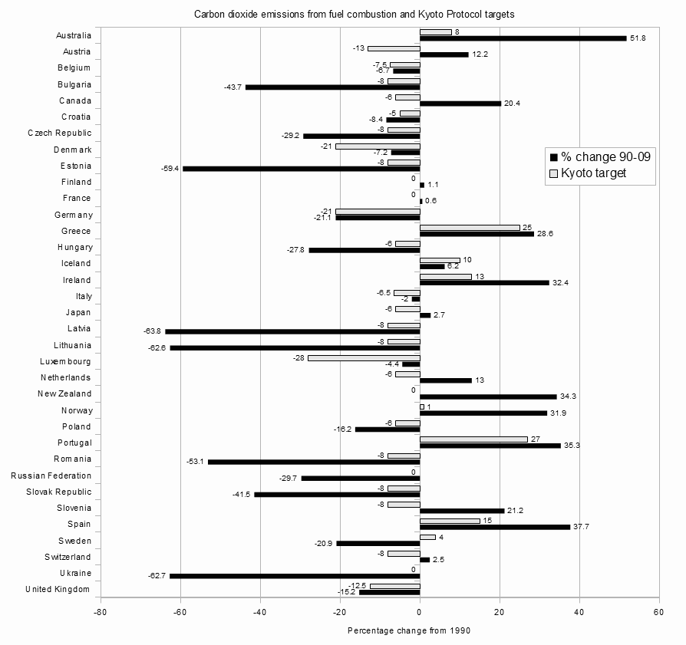
A Short History of Actions on Climate Change
1997 – Kyoto Protocol
Enescot – https://commons.wikimedia.org/wiki/File:Kyoto_Parties_with_first_period_(2008-2012)_greenhouse_gas_emissions_limitations_targets_and_the_percentage_change_in_their_carbon_dioxide _emissions_from_fuel_combustion_between_1990_and_2009.png – CC BY-SA 3.0.

Slide 28
A Short History of Actions on Climate Change
2009 – Copenhagen Accord
Drafted by only 5 countries
Not legally binding
No real targets
Content:
Endorses the continuation of the Kyoto Protocol
“We emphasise our strong political will to urgently combat climate change in accordance with the principle of common but differentiated responsibilities and respective capabilities”
“We shall, recognizing the scientific view that the increase in global temperature should be below 2 degrees Celsius”
United Nations (2009) – Copenhagen Accord – https://unfccc.int/resource/docs/2009/cop15/eng/l07.pdf

Slide 29
A Short History of Actions on Climate Change
2009 – Copenhagen Accord
Drafted by only 5 countries
Not legally binding
No real targets
Content:
Endorses the continuation of the Kyoto Protocol
“We emphasise our strong political will to urgently combat climate change in accordance with the principle of common but differentiated responsibilities and respective capabilities”
“We shall, recognizing the scientific view that the increase in global temperature should be below 2 degrees Celsius”
United Nations (2009) – Copenhagen Accord – https://unfccc.int/resource/docs/2009/cop15/eng/l07.pdf

Slide 30
A Short History of Actions on Climate Change
2009 – Copenhagen Accord
Drafted by only 5 countries
Not legally binding
No real targets
Content:
Endorses the continuation of the Kyoto Protocol
“We emphasise our strong political will to urgently combat climate change in accordance with the principle of common but differentiated responsibilities and respective capabilities”
“We shall, recognizing the scientific view that the increase in global temperature should be below 2 degrees Celsius”
United Nations (2009) – Copenhagen Accord – https://unfccc.int/resource/docs/2009/cop15/eng/l07.pdf

Slide 31
A Short History of Actions on Climate Change
2009 – Copenhagen Accord
Drafted by only 5 countries
Not legally binding
No real targets
Content:
Endorses the continuation of the Kyoto Protocol
“We emphasise our strong political will to urgently combat climate change in accordance with the principle of common but differentiated responsibilities and respective capabilities”
“We shall, recognizing the scientific view that the increase in global temperature should be below 2 degrees Celsius”
United Nations (2009) – Copenhagen Accord – https://unfccc.int/resource/docs/2009/cop15/eng/l07.pdf

Slide 32
A Short History of Actions on Climate Change
2015 – Paris Agreement
Reach global peaking of greenhouse gas emissions as soon as possible
Holding the increase in the global average temperature to well below 2°C above pre-industrial levels
Pursuing efforts to limit the temperature increase to 1.5°C above pre-industrial levels, recognizing that this would significantly reduce the risks and impacts of climate change;
Increasing the ability to adapt to the adverse impacts of climate change and foster climate resilience and low greenhouse gas emissions development, in a manner that does not threaten food production; and
Making finance flows consistent with a pathway towards low greenhouse gas emissions and climate-resilient development.
United Nations (2015) – Paris Agreement – https://unfccc.int/sites/default/files/english_paris_agreement.pdf

Slide 33
A Short History of Actions on Climate Change
2015 – Paris Agreement
Reach global peaking of greenhouse gas emissions as soon as possible
Holding the increase in the global average temperature to well below 2°C above pre-industrial levels
Pursuing efforts to limit the temperature increase to 1.5°C above pre-industrial levels, recognizing that this would significantly reduce the risks and impacts of climate change;
Increasing the ability to adapt to the adverse impacts of climate change and foster climate resilience and low greenhouse gas emissions development, in a manner that does not threaten food production; and
Making finance flows consistent with a pathway towards low greenhouse gas emissions and climate-resilient development.
United Nations (2015) – Paris Agreement – https://unfccc.int/sites/default/files/english_paris_agreement.pdf

Slide 34
A Short History of Actions on Climate Change
2015 – Paris Agreement
Reach global peaking of greenhouse gas emissions as soon as possible
Holding the increase in the global average temperature to well below 2°C above pre-industrial levels
Pursuing efforts to limit the temperature increase to 1.5°C above pre-industrial levels, recognizing that this would significantly reduce the risks and impacts of climate change;
Increasing the ability to adapt to the adverse impacts of climate change and foster climate resilience and low greenhouse gas emissions development, in a manner that does not threaten food production; and
Making finance flows consistent with a pathway towards low greenhouse gas emissions and climate-resilient development.
United Nations (2015) – Paris Agreement – https://unfccc.int/sites/default/files/english_paris_agreement.pdf

Slide 35
A Short History of Actions on Climate Change
2015 – Paris Agreement
Reach global peaking of greenhouse gas emissions as soon as possible
Holding the increase in the global average temperature to well below 2°C above pre-industrial levels
Pursuing efforts to limit the temperature increase to 1.5°C above pre-industrial levels, recognizing that this would significantly reduce the risks and impacts of climate change;
Increasing the ability to adapt to the adverse impacts of climate change and foster climate resilience and low greenhouse gas emissions development, in a manner that does not threaten food production; and
Making finance flows consistent with a pathway towards low greenhouse gas emissions and climate-resilient development.
United Nations (2015) – Paris Agreement – https://unfccc.int/sites/default/files/english_paris_agreement.pdf

Slide 36
A Short History of Actions on Climate Change
2015 – Paris Agreement
Reach global peaking of greenhouse gas emissions as soon as possible
Holding the increase in the global average temperature to well below 2°C above pre-industrial levels
Pursuing efforts to limit the temperature increase to 1.5°C above pre-industrial levels, recognizing that this would significantly reduce the risks and impacts of climate change;
Increasing the ability to adapt to the adverse impacts of climate change and foster climate resilience and low greenhouse gas emissions development, in a manner that does not threaten food production; and
Making finance flows consistent with a pathway towards low greenhouse gas emissions and climate-resilient development.
United Nations (2015) – Paris Agreement – https://unfccc.int/sites/default/files/english_paris_agreement.pdf

Slide 37
A Short History of Actions on Climate Change
2021 – Glasgow Climate Pact
Reaffirms the Paris Agreement temperature goal of holding the increase in the global average temperature to well below 2 °C above pre-industrial levels and pursuing efforts to limit the temperature increase to 1.5 °C above pre-industrial levels
Including accelerating efforts towards the phase-out of unabated coal power and inefficient fossil fuel subsidies
Urges developed country Parties to provide enhanced support, including through financial resources, technology transfer and capacity-building, to assist developing country
United Nations (2021) – Glasgow Climate Pact – https://unfccc.int/sites/default/files/resource/cma2021_L16_adv.pdf

Slide 38
A Short History of Actions on Climate Change
2021 – Glasgow Climate Pact
Reaffirms the Paris Agreement temperature goal of holding the increase in the global average temperature to well below 2 °C above pre-industrial levels and pursuing efforts to limit the temperature increase to 1.5 °C above pre-industrial levels
Including accelerating efforts towards the phase-out of unabated coal power and inefficient fossil fuel subsidies
Urges developed country Parties to provide enhanced support, including through financial resources, technology transfer and capacity-building, to assist developing country
United Nations (2021) – Glasgow Climate Pact – https://unfccc.int/sites/default/files/resource/cma2021_L16_adv.pdf

Slide 39
A Short History of Actions on Climate Change
2021 – Glasgow Climate Pact
Reaffirms the Paris Agreement temperature goal of holding the increase in the global average temperature to well below 2 °C above pre-industrial levels and pursuing efforts to limit the temperature increase to 1.5 °C above pre-industrial levels
Including accelerating efforts towards the phase-out of unabated coal power and inefficient fossil fuel subsidies
Urges developed country Parties to provide enhanced support, including through financial resources, technology transfer and capacity-building, to assist developing country
United Nations (2021) – Glasgow Climate Pact – https://unfccc.int/sites/default/files/resource/cma2021_L16_adv.pdf

Slide 40
A Short History of Actions on Climate Change
2021 – Glasgow Climate Pact
140 countries pledged to reach net-zero emissions
100+ countries pledged to reverse deforestation by 2030
40+ countries pledged to move away from coal
United Nations (2021) – Glasgow Climate Pact – https://unfccc.int/sites/default/files/resource/cma2021_L16_adv.pdf

Slide 41
A Short History of Actions on Climate Change
2022/23 – COP27/28 (United Nations Climate Change Conference)
COP27 in Sharm el-Sheikh, Egypt
No relevant results
But, more than 600 fossil fuels lobbyists registered to attend
COP28 in Dubai
Designated president for COP28: Sultan Al Jaber → CEO of Abu Dhabi National Oil Company
Ruth Michaelson | The Guardian (2022) – https://www.theguardian.com/environment/2022/nov/10/big-rise-in-number-of-fossil-fuel-lobbyists-at-cop27-climate-summit

Slide 42
A Short History of Actions on Climate Change
2022/23 – COP27/28 (United Nations Climate Change Conference)
COP27 in Sharm el-Sheikh, Egypt
No relevant results
But, more than 600 fossil fuels lobbyists registered to attend
COP28 in Dubai
Designated president for COP28: Sultan Al Jaber → CEO of Abu Dhabi National Oil Company
Ruth Michaelson | The Guardian (2022) – https://www.theguardian.com/environment/2022/nov/10/big-rise-in-number-of-fossil-fuel-lobbyists-at-cop27-climate-summit

Slide 43
What to expect of COP28?
Bla, bla bla – Link

Slide 44
Activism

Slide 45
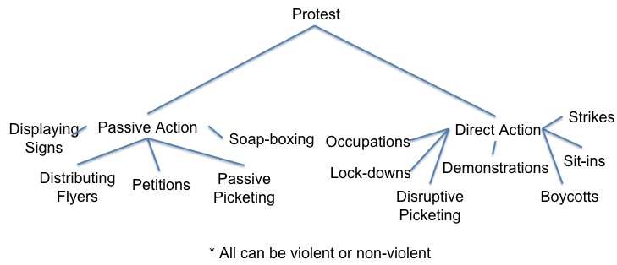
Activism
Types of Political Protest
A framework for explaining social movements. Dino Bozonelos, Julia Wendt, Charlotte Lee, Jessica Scarffe, Masahiro Omae, Josh Franco, Byran Martin, & Stefan Veldhuis – CC BY-SA 4.0. https://socialsci.libretexts.org/Courses/Mizzou_Academy/AP_Comparative_Government_and_Politics/09%3A_Collective_Action_and_Social_Movements/9.03%3A_A_framework_for_explaining_social_movements
.

Slide 46
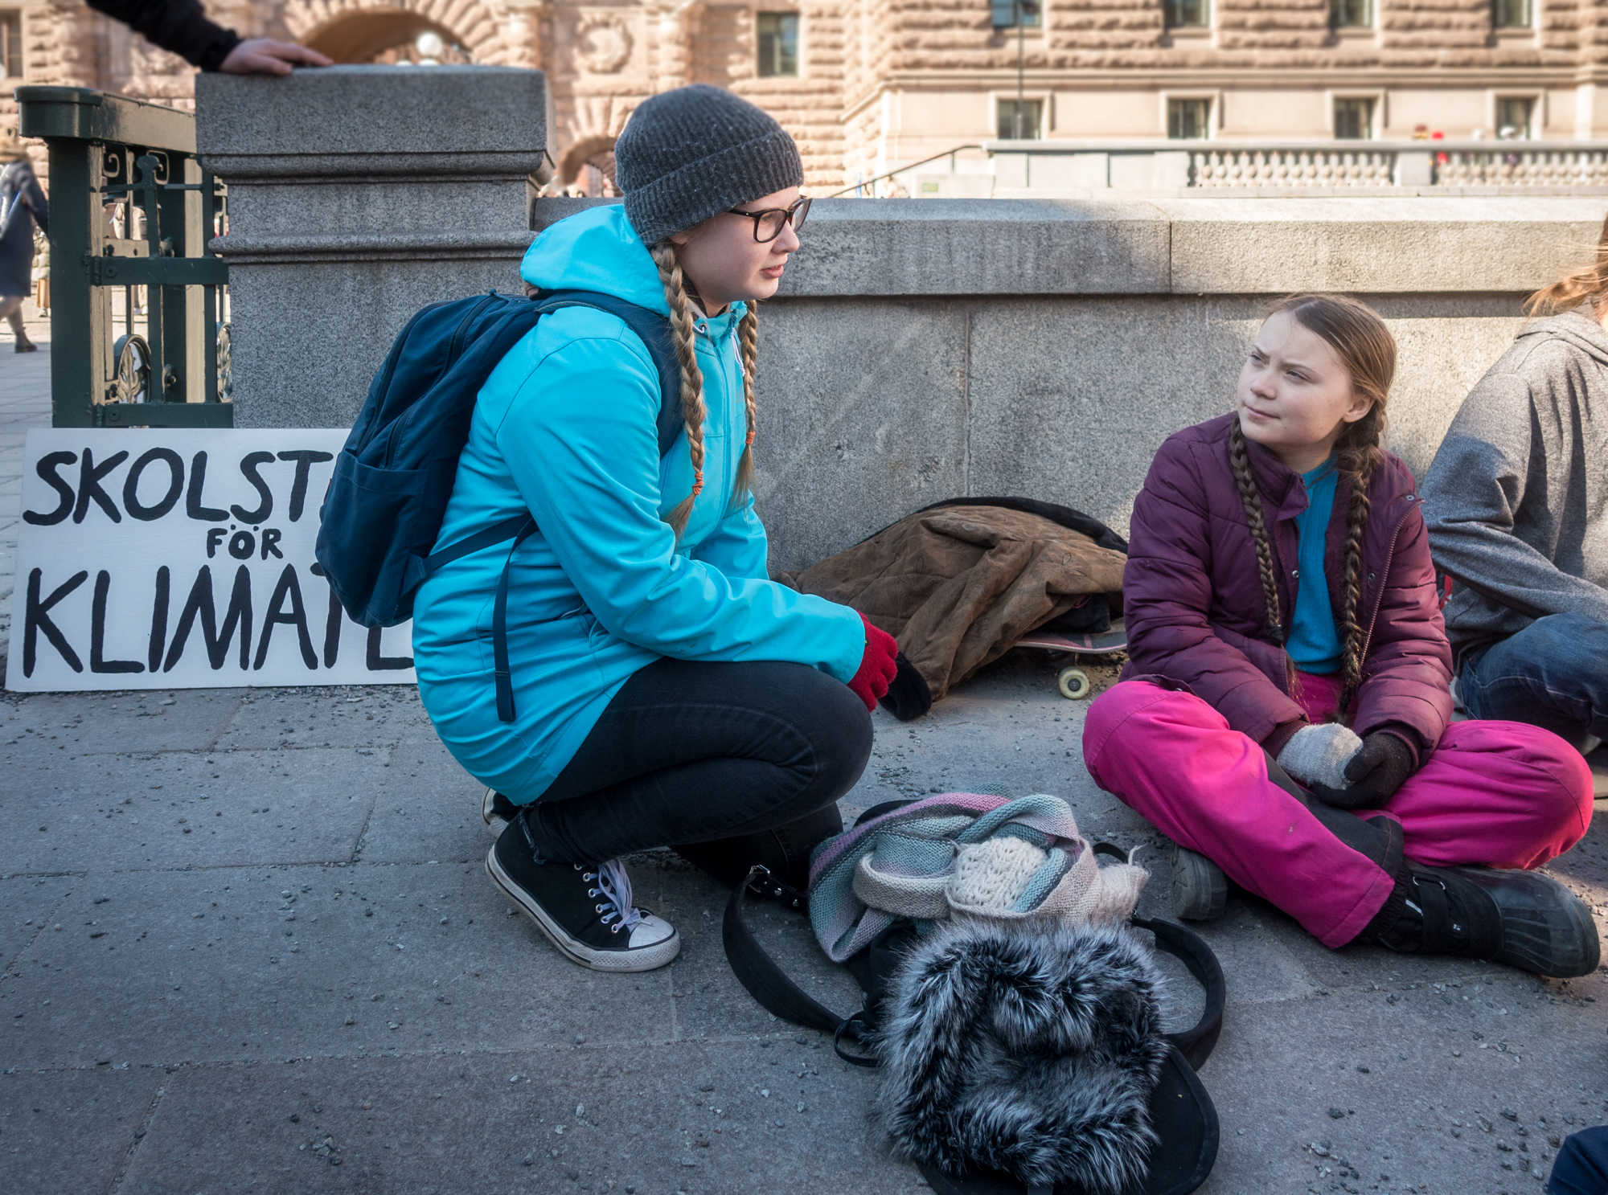
Activism
Fridays for Future
Frankie Fouganthin (2019) – https://commons.wikimedia.org/wiki/File:Greta_Thunberg_in_School_strike_for_the_climate.jpg – CC BY-SA 4.0.

Slide 47
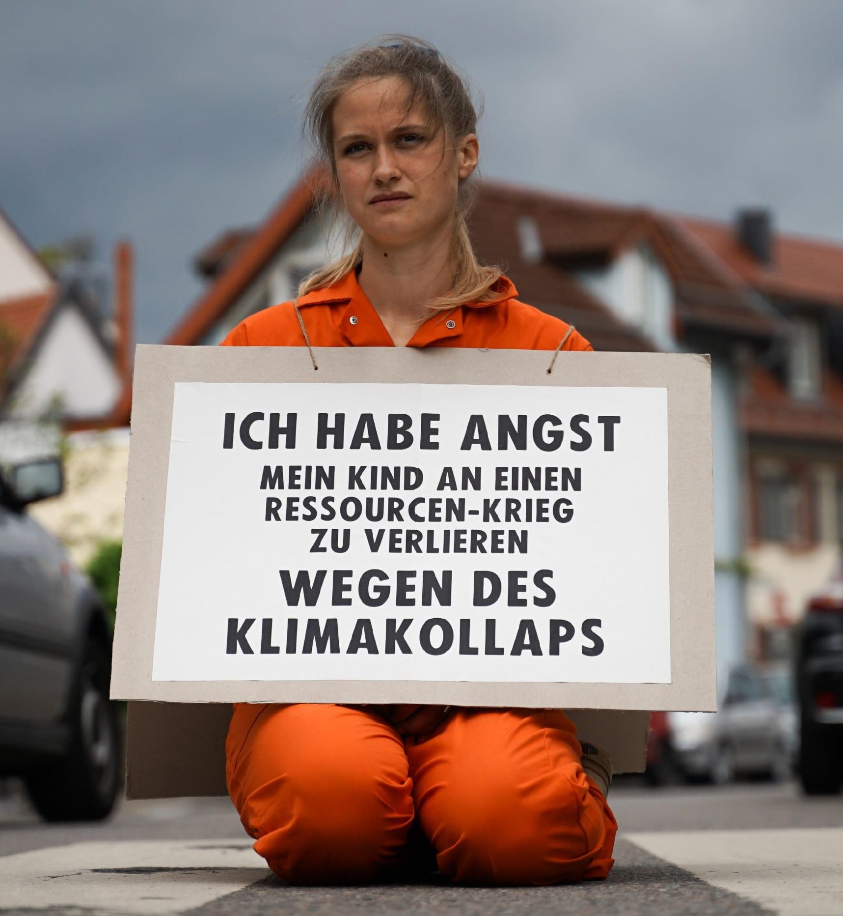
Activism
Extinction Rebellion (XR)
“I am afraid of losing my child to a resource war because of a climate collapse”
XR Strategiepapier 2022 – Pusteblumen und Hype. Bilder: Sebastian Höhn, Joe Pohl, Sandra Doneck, Alessandro Brönnimann

Slide 48
Activism
Extinction Rebellion (XR)
Vladimir Morozov (2019) – https://xrbristol.org.uk/2020/04/17/blog-xr-has-sticking-power/ – CC BY-SA 4.0.

Slide 49
Activism
“Climate activists are sometimes depicted as dangerous radicals, but the truly dangerous radicals are the countries that are increasing the production of fossil fuels.”
United Nations Secretary General Antonio Guterres

Slide 50
Activism
“Climate activists are sometimes depicted as dangerous radicals, but the truly dangerous radicals are the countries that are increasing the production of fossil fuels.”
United Nations Secretary General Antonio Guterres

Slide 51
Activism
Extinction Rebellion (XR)
Beyond just protesting (Lars Werner): Link

Slide 52
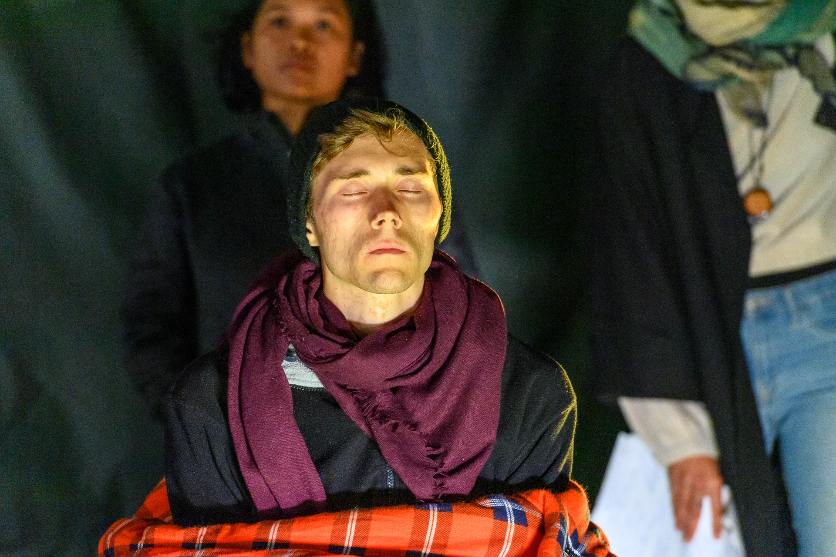
Activism
Last Generation (Letzte Generation)
2021 → before the elections in Germany
27 days hunger strike (picture day 25) → afterwards Intensive Care Unit
Together with other climate activists, Jeschke wanted to use this drastic means to draw attention to the climate crisis and achieve a discussion with the candidates for chancellor.
Olaf Scholz (Chancellor Germany) and Last Generation → Video
Stefan Müller (2021) – https://www.flickr.com/photos/184802432@N05/51541641486 – CC BY 2.0.

Slide 53
Activism
Neubauer, et al. vs. Germany
https://www.germanwatch.org/en/node/20134

Slide 54
Activism
Neubauer, et al. vs. Germany
Nine young people from Germany sued Germany
They argue: “that the goals and measures of the Federal Climate Protection Act are not sufficient to effectively protect their fundamental rights from the consequences of the climate crisis as well as to fulfill the government’s obligations under the Paris Agreement.”
They won! → “Freedoms and fundamental rights are already being violated today by insufficient climate protection. The legislator must adapt the Federal Climate Protection Act by the end of 2022”
“Climate protection is not nice-to-have, fair climate protection is a fundamental right, that is now official. A huge success - for everyone and especially for us young people who have been on climate strike for their future for over two years. We will now continue to fight for a 1.5 degree policy that is fair to all generations.” – Luisa Neubauer
https://www.germanwatch.org/en/node/20134

Slide 55
Activism
Neubauer, et al. vs. Germany
Nine young people from Germany sued Germany
They argue: “that the goals and measures of the Federal Climate Protection Act are not sufficient to effectively protect their fundamental rights from the consequences of the climate crisis as well as to fulfill the government’s obligations under the Paris Agreement.”
They won! → “Freedoms and fundamental rights are already being violated today by insufficient climate protection. The legislator must adapt the Federal Climate Protection Act by the end of 2022”
“Climate protection is not nice-to-have, fair climate protection is a fundamental right, that is now official. A huge success - for everyone and especially for us young people who have been on climate strike for their future for over two years. We will now continue to fight for a 1.5 degree policy that is fair to all generations.” – Luisa Neubauer
https://www.germanwatch.org/en/node/20134

Slide 56
Conclusion

Slide 57
Conclusion
Sustainable Development Goals → SDGs
Short history of actions on climate change
Geneva, Kyoto, Copenhagen, Paris, Glasgow, etc.
Problem
→ A lot of bla, bla, bla
→ Lack of progress
→ Policies favor business as usual instead of acting in accordance with science because they are afraid to make unpopular decisions
Individual activism as a response / counter movement to inactive governments who ignore urgent issues (i.e., the three key challenges of the 21st century)

Slide 58
Exercise E03

Slide 59
Exercise E03
Individual Action
Addressing climate change requires collective efforts on individual, community, national, and global levels. In the lecture, we discussed the international and national perspectives. For the exercise, we want to look at what can be done on the community and individual levels.
Work through the MOOC content for L04 (Link). There you will learn about sustainable everyday practices and the problem of food waste.
Watch all the videos, read all the texts and answer the questions.
In the lecture, we discussed the history of international and national actions. In part 1 of the exercise you have learned about individual actions and what a single person can do.
In your opinion, what is more important when it comes to fighting climate change (and the other challenges we have discussed)? (1) Political Action (e.g. on the international or national level), (2) Collective Action (e.g. activism, protests) or (3) Individual Action (e.g. what you yourself can do).
Explain your choice.
Submit your result according to the submission guidelines posted in the exercise sheet → E03.

Slide 60
Additional Resources
Podcast Episode: How to Save a Planet (2021) – We Go Inside the COP26 Climate Talks – Link
Greta Thunberg mocks world leaders in 'blah, blah, blah' speech | BBC News (2021) – Link
Rutger Bregman tells Davos to talk about tax: 'This is not rocket science' | Guardian News (2019) – Link
IPCC (2022) – About the IPCC – Link
Richard Black, BBC (2013) – A brief history of climate change – Link

Slide 61
Questions?

